Slide 1

47 RONING Investment Group
Your financial trust
is our most valuable asset

Slide 2
About Us: Redefining Investment for a New Generation
We are not just an investment firm. We are a collective of forward-thinking, young minds working together to facilitate financial freedom to our partners.
Our mission? Empowering our generation to embrace the stock market and challenge the conventional.
Drawing inspiration from the timeless wisdom of the Ninja Philosophy, we abide by a foundational principle: "Ultimately, the responsibility for your training is your own." It's not just about investing; it's about guiding individuals to take ownership of their financial journey.
Our dedication to the 47 Ronin teachings is reflected in our strategy. Just as they honored their code with 47 warriors, we honor theirs by investing in a disciplined count of 47 companies. Quality over quantity, mirroring the integrity of these legendary figures.

Slide 3
Our Offer: Redefining Accessible Investing
Embracing the digital era, we are a fully online firm. By cutting unnecessary costs, we provide unparalleled value, ensuring that every investment is optimized for our clients' success.
Disrupting the norm, our self-assessment tool determines your risk profile—conservative, moderate, or aggressive—crafting a personalized stock package proposal aligned with your financial identity.
We're your shortcut to financial independence, just a click away. Our intuitive platform offers easy access from any location, at any time.
Simplified, personalized, and always accessible—empowering you to drive your financial destiny.

Slide 4
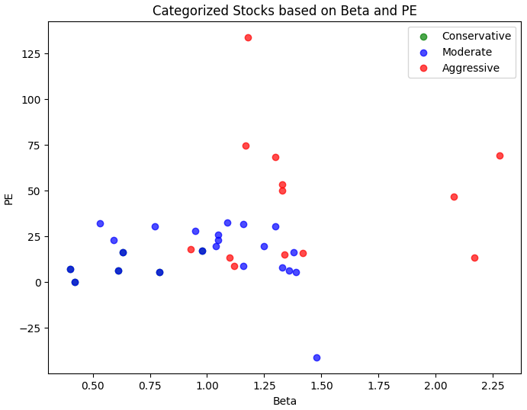
What is our methodology?
We invest in the Top 47 stocks of the S&P 500 and we based our analysis in 3 key metrics:
Beta: measure of the volatility—or systematic risk— of a stock or portfolio compared to the market as a whole
Stocks with betas higher than 1.0 can be interpreted as more volatile than the S&P 500
P/E ratio: also known as an “earnings multiple,” is the stock price divided by earnings per share (EPS).
average P/E ratio is around 20 to 25. Anything below that would be considered a good price-to-earnings ratio, whereas anything above that would be a worse P/E ratio
EPS: profitability measure used in relating a stock's price to a company's actual earnings
The higher a company's EPS, the more profitable it is considered to be
In our model, about 55.55% of the time our stocks are classified into their appropriate categories based on the provided features (Beta, PE, and EPS).
Notes:
standard approach for training a classification model, making predictions, and evaluating its performance using accuracy as a metric.Helping us to understand how well our logic regression model is performing in predicting stock categories based on the provided features.

Slide 5
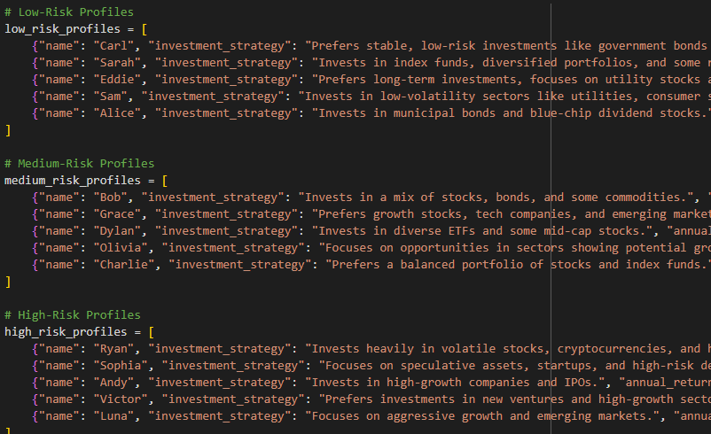
Service Delivery: Self-Discovery Through Risk Assessment
Our services are facilitated via a self-service tool.
Clients are encouraged to tap into their inner selves, utilizing our guidance to determine their comfort level in handling risk.
It's a journey of self-discovery, simplified with our assistance

Slide 6
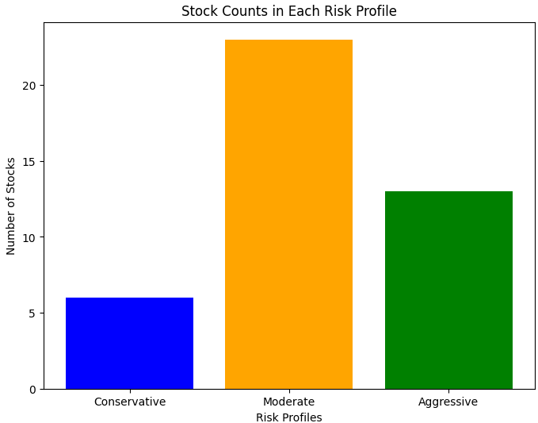
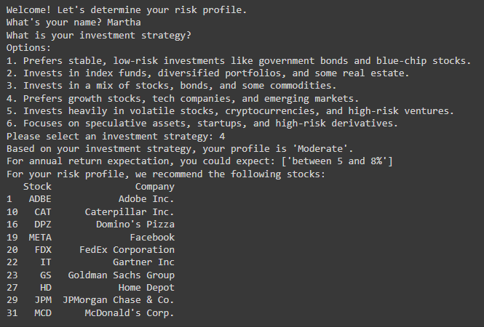
Service Delivery: Self-Discovery Through Risk Assessment

Slide 7

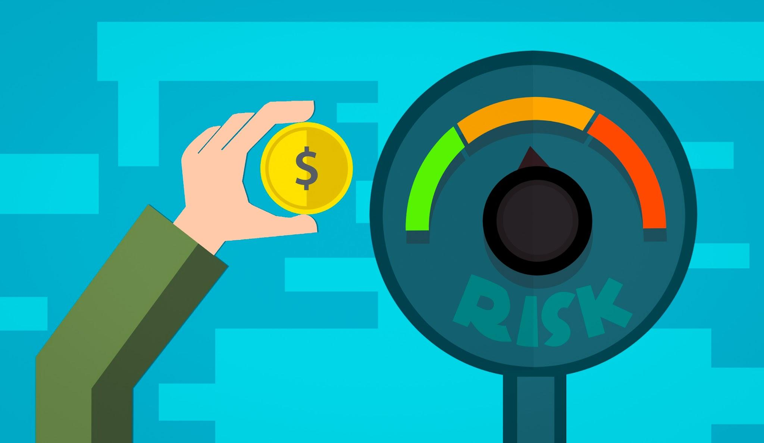

Our partners speak for ourselves
Martha
Nov 2022
Moderate risk
$500 initial investment
$100 every month for 12 months

Slide 8
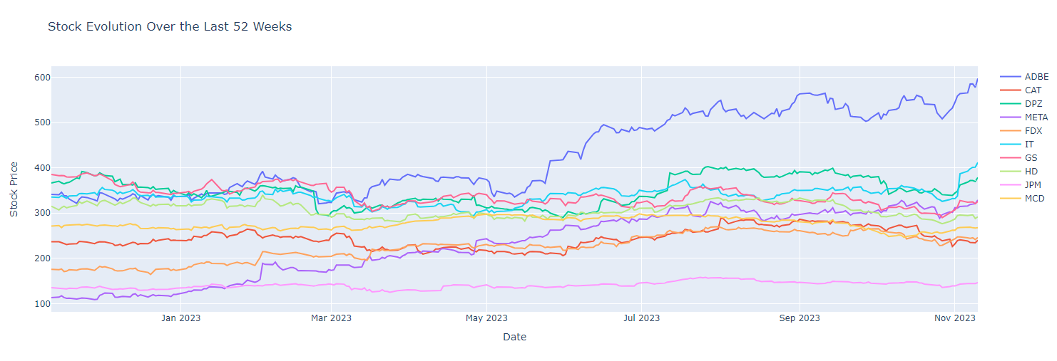
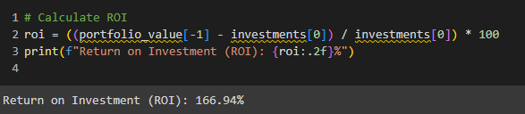
Our partners speak for ourselves
ROI… 166%

Slide 9
THANK YOU

